Slide 1
Best Practices for Schools & Law Enforcement
Key Issues & Strategies
April 2014
Lisa H. Thurau

Slide 2
How to Protect those We Serve from Ourselves
Demons:
Inner sadist
Racism/Fear
Assumptions about Professions
Immaturity
“It’s never been this bad.”

Slide 3
Keys to Good Safety Teams Involving Adults in Schools
Clarity of Purpose
Team Approach & Role Definition
Training
Data Collection
Oversight

Slide 4
1. CLARITY of PURPOSE
What expectations do we have of what youth need to behave well?
What’s our ADD Bandwidth?
Socializing
Clarity of expectations
Reinforcement
What’s our theory of students’ poor classroom behavior?
What’s our theory of improving student behavior?
How do we fetter our discretion/our inner demons?
Zero tolerance?
Graduated Sanctions?

Slide 5
2. TEAM APPROACH
KEY FACTORS:
Principal leadership role of team
Voice in selection of SRO and deployment
SRO deployment issues must be analyzed and evaluated
Role definition
Role adherence/flexibility
Avoid delegation of “the heavy” role solely to police
Recognition of who plays which roles best
Frequent, regular check-ins as a team
SRO Role
Deployment!
Capitalize on SRO’s access to information on students’ involvement in law enforcement-related systems A&N/DV.

Slide 6
2(A). Team Responses
Team Commitments/Agreements:
Use agreed-upon approach
Structure and roles should trump personalities
Promote predictability in adult responses
Constant evaluation of efforts
Commitment to tweak/change

Slide 7
What Makes a Team Fail/Succeed?
FAIL
SUCCEED
Inattention to results.
Avoidance of accountability.
Lack of commitment.
Fear of conflict.
Absence of trust.
Team members trust one another.
Engage in unfiltered conflict about ideas.
Commit to decisions and plans of action.
Hold one another accountable for delivering plans.
Focus on achievement of collective results.
Source: Dysfunctions of a Team by Patrick Lencioni

Slide 8
3(A) TRAINING for ADULTS
WHAT:
Child & Adolescent Development
Impacts of Chronic Exposure to Trauma
Demographics Factors Affecting Home/Nbhd Lives of Children/Youth
Cultural Factors Influencing Youth Behaviors/Survival Tactics
Juvenile Law for Law Enforcement in Schools
Understand limited responses of juvenile courts
Value of restorative justice approaches
Implicit Bias
ADR-mediation training to Teach Youth Skills for De-Escalating Disputes
Understanding How Youth Perceive Assertion of Authority

Slide 9
HOW:
As a team (including teachers, janitors, lunch ladies, nurses,
psychologistst/guidance counselors)
Developmental/psychological
Scenario based & interactive
Small-group
Annually (shorter)

Slide 10
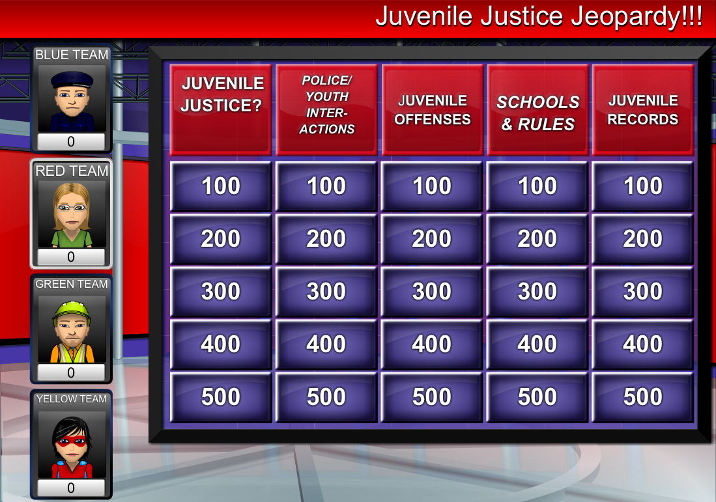
3(B) TRAINING for STUDENTS
School Code Rules
JJJeopardy for School Code
Allocate time to teaching the
Code of conduct using:
Interactive method
Make assumptions clear
Model ways students should address anticipated disputes
Provide alternatives and adults to speak to

Slide 11
4. DATA COLLECTION
“Can’t manage what you can’t measure.”
Focus on HOW adults are responding to youth;
Count suspensions/expulsions, & referrals by teachers & administrators to SROs by:
Age/Race/Gender of Youth
Kind of dispute/issue
Resulting action
Parental involvement
Avoid anecdotes except to illustrate a trend
Analyze data routinely by different team members
Require “juncture” analysis
Assign team members to figure out solutions for adult responses

Slide 12
5. OVERSIGHT
WHO: Internal: Safety Team Members
External: Central Oversight Agencies
HOW: Statistical Data on Adult Decisions
Climate Survey of Students/Teachers
WHAT: Use of exclusion tactics Sense of safety/predictability/fairness
WHEN: Statistical Data: Monthly/Annually

Slide 13
Worth Reading:
Astor, Ron Avi et al., “School Violence and Theoretically Atypical Schools: The Principal’s Centrality in Orchestrating Safe Schools,” American Education Research Journal, 2009.
Education Development Corporation, Creating Supportive Environments that Promote Student Safety and Academic Achievement.” (2013)
Catherine Kim, White Paper: Policing In Schools: Developing A Governance Document For School Resource Officers In K-12 Schools, (2009) ACLUhttp://www.aclu.org/racial-justice/policing-schools-developing-governance-document-school-resource-officers-k-12-schools
Wald and Thurau, First, Do No Harm, www.strategiesforyouth.org/publications

