Slide 1
Best Practices for Schools & Law Enforcement
Key Issues & Strategies
April 2014
Lisa H. Thurau

Slide 2
Discipline
“It takes tremendous discipline to control the influence, the power you have over other people’s lives.” -Clint Eastwood

Slide 3
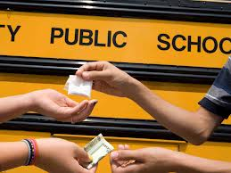
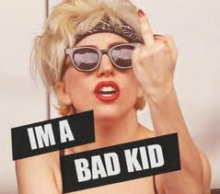
Bad Kids, Bad Kids: What you Gonna Do?

Slide 5
Consider
For whom is the school safe?
Who does not feel safe?
Why?

Slide 6
Keys to Good Safety Teams Involving Adults in Schools
Clarity of Purpose
Team Approach & Role Definition
Involving the Community
Training
Data Collection
Oversight

Slide 7
Worth Reading:
Astor, Ron Avi et al., “School Violence and Theoretically Atypical Schools: The Principal’s Centrality in Orchestrating Safe Schools,” American Education Research Journal, 2009.
Education Development Corporation, Creating Supportive Environments that Promote Student Safety and Academic Achievement.” (2013)
Catherine Kim, White Paper: Policing In Schools: Developing A Governance Document For School Resource Officers In K-12 Schools, (2009) ACLUhttp://www.aclu.org/racial-justice/policing-schools-developing-governance-document-school-resource-officers-k-12-schools
Wald and Thurau, First, Do No Harm, www.strategiesforyouth.org/publications

